Slide 1






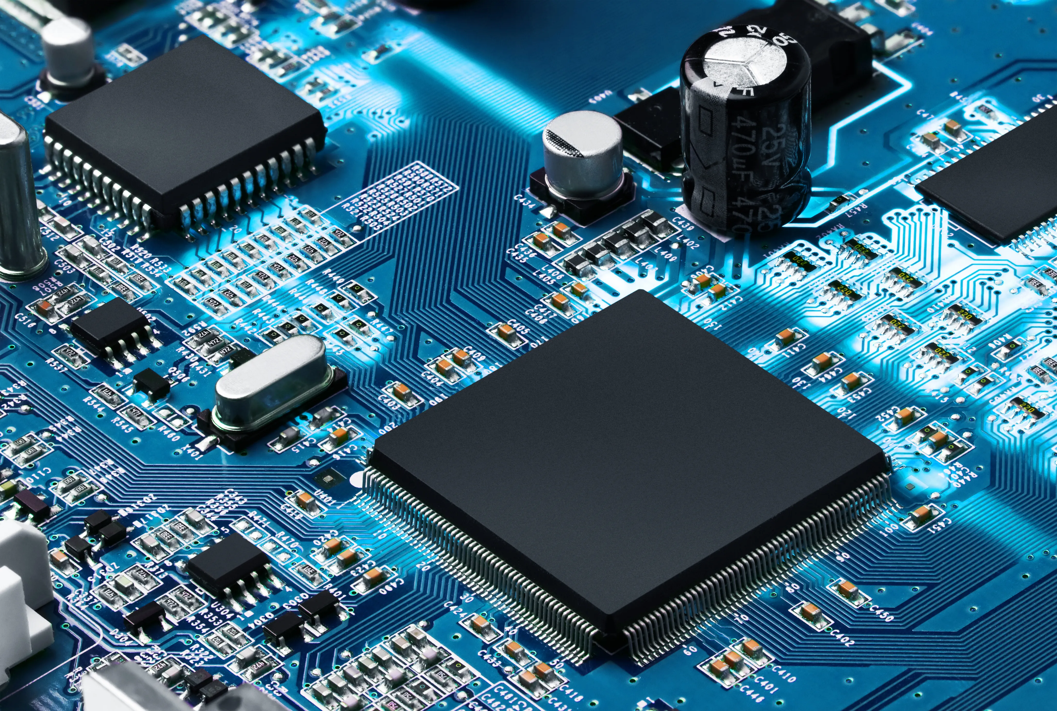
St. Francis Institute of Technology
An Autonomous Institute, Affiliated to University of Mumbai
NAAC A+ Accredited | CMPN, EXTC, INFT NBA Accredited | ISO 9001:2015 Certified
www.sfit.ac.in | sfedu@sfit.ac.in | 9167370622
Genesis 2024
Genesis
EXTC SFIT
Intercollege Mini-Project Competition for
TE EXTC Students based on
Miniproject 2A: Embedded System
Organized by
Electronics and Telecommunication Engineering Department
25th October 2024
Cash Prizes for Top Three Winners
Registration Fees: Rs. 300/- per group
Contact Details
9325758319
(Dr. R. Chaudhari)
9821199527
(Dr. K. Jayasudha)
Website: www.sfit.ac.in
Registration Link: https://forms.gle/1twLio92h9bUPnucA
Dr. Kevin Noronha Dr Ravindra Chaudhari Dr. Jayasudha Koti Dr. Anjali Chaudhari Ms. Savita Kulkarni
( HOD EXTC) (Coordinator) (Coordinator) (Coordinator) (Coordinator)

